Slide 1

EDA Final
周昀、劉芸欣、高紹芳

Slide 2
Outline
Problem define
Original approach
New approach
Test results
Future work
Work assignment

Slide 3
Outline
Problem define
Original approach
New approach
Test results
Future work
Work assignment

Slide 4
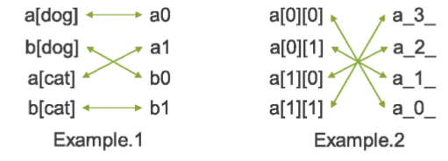
2018 ICCAD Problem A
The name mapping problem

Slide 5
Outline
Problem define
Original approach
New approach
Test results
Future work
Work assignment

Slide 6
Original approach
Our original idea was to build a hash function from which the hash number of a string reflects the order of the string in the sequence.
Objective: Find a vector f such that for any two vector x₁ and x₂, if x₁ > x₂, then x₁^{T} f > x₂^{T} f.

Slide 7
Basic Idea
We sort the string pairs.
Try to build the hash function.
1
2
3

Slide 8
Basic Idea
When we get the two groups of strings.
Sort the first group, and find a hash number for each string in the second group.
And sort the second group.
3
1
2
1
2
3

Slide 9
But !
The new updated FAQ clarifies that the number of input strings guarantee to be the same with the number of testing strings.
Analyzing the string is not essential any more. The problem becomes simply reversing a permutation.

Slide 10
Outline
Problem define
Original approach
New approach
Test results
Future work
Work assignment

Slide 11
New approach
We came up with a new algorithm to reverse the permutation by simply searching for matched string and shifting the sequence.
This design is based on the observation that sorting order of the “first strings” is similar of the “second strings”.

Slide 12
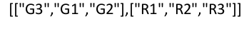
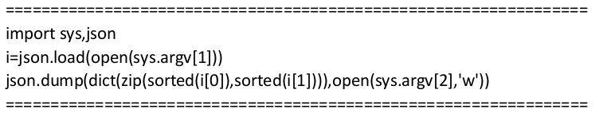
Sorting
By sorting the input pairs, we convert the notation from strings to integers.

Slide 13
Shifting and Insertion
We go through the string pairs the record the needed movement with integer pairs as ( target_position, insert_position)
1 | A
2 | C
3 | D
4 | E
5 | B
1 | A
2 | B
3 | C
4 | D
5 | E

Slide 14
Workflow
Main Program :
Python Script :
Sort the string pair
Sort the first string
Sort the second string
Sort the second string
Find shifting position
Make the shifting

Slide 15
Outline
Problem define
Original approach
New approach
Test results
Future work
Work assignment

Slide 16
Test result
Case | Number of character
case0 | 125
case1 | 88381
case2 | 89388
case3 | 6577
case4 | 227
case5 | 83158
case6 | 1789
case7 | 1780
case8 | 5001

Slide 17
Outline
Problem define
Original approach
New approach
Test results
Future work
Work assignment

Slide 18
Future work
Reverse order shifting
We now go through the sequence by ascending order and record the intended movements, however, there is a chance that the script gets shorter by descending order.
Block movement
Try to move block instead of single pair.
Hexadecimal notation

Slide 19
Outline
Problem define
Original approach
New approach
Test results
Future work
Work assignment

Slide 20
Work Assignment
周昀：Main Algorithm
芸欣：Parsing and Data Structure
紹芳：Output Final Python Script
All：Presentation and Demo

Slide 21
Thank You

